Slide 1
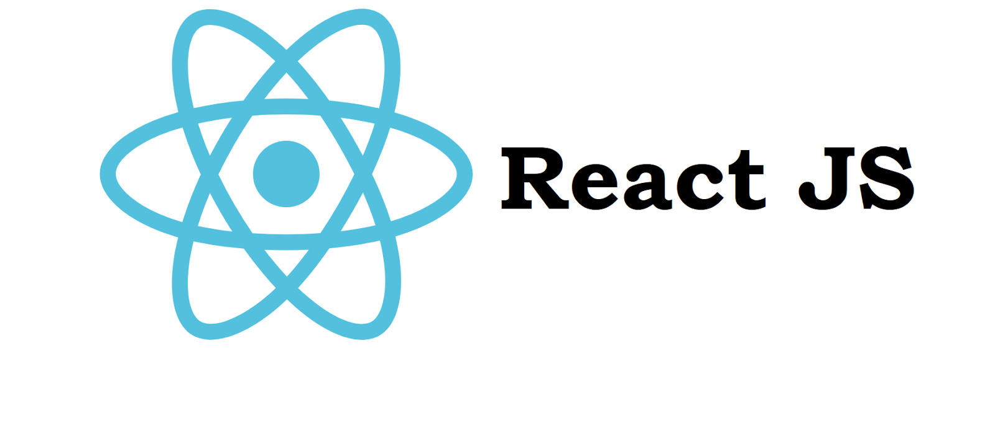

Slide 2
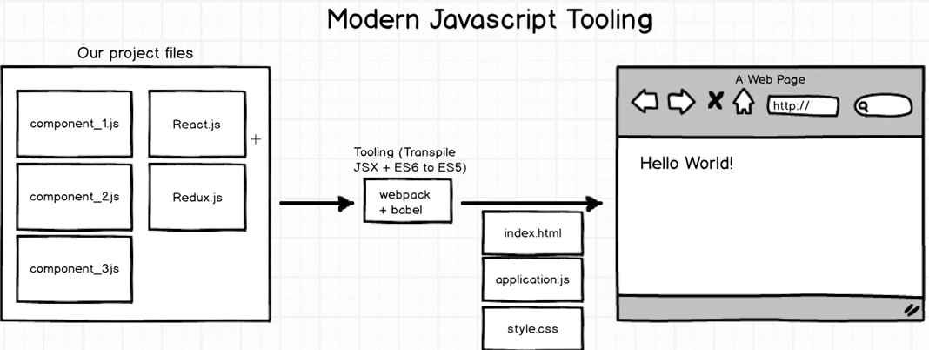
Process flow

Slide 3
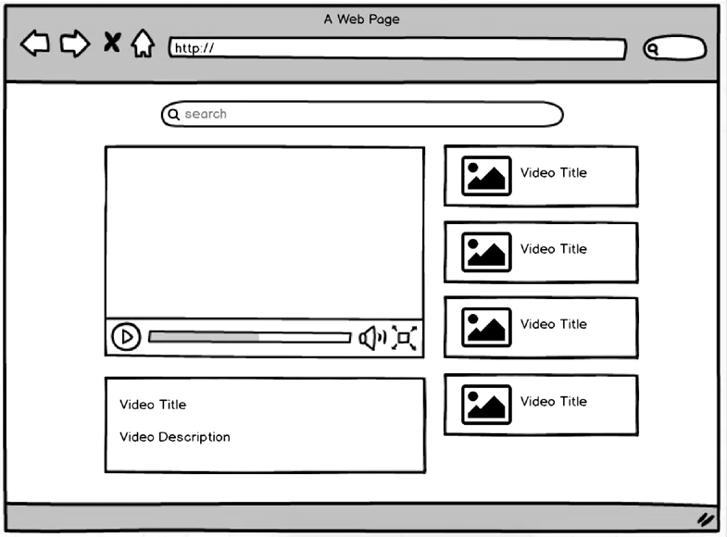
Download a sample project
https://github.com/StephenGrider/ReduxSimpleStarter
Go to projectyrepository
Run npm install
Run npm start
Open localhost:8080
Open the project in
Editor.

Slide 4
index.html is the webpage that we see on localhost:8080
It has bundle.js which is created by webpack and bable and it bundles all the js files in our code.

Slide 5
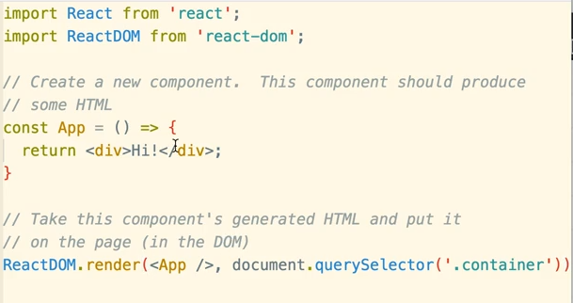
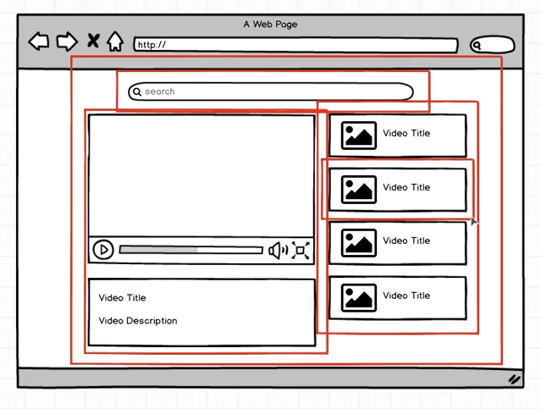
Dividing the page into components

Slide 6
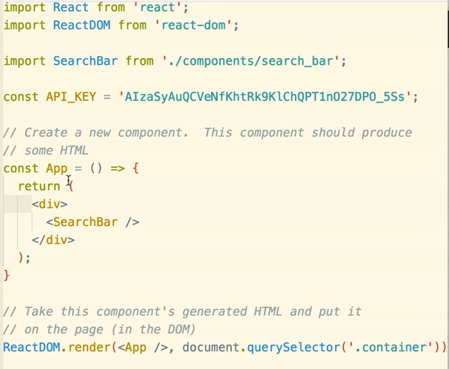
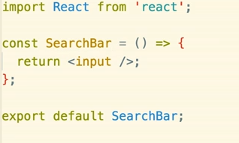
1 component per file (function component)
Create a folder components and 1 file per component.
Get the youtube
api key for data.
Npm install - -save
youtube-api-search

Slide 7
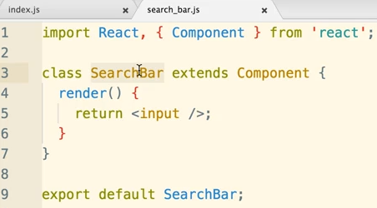
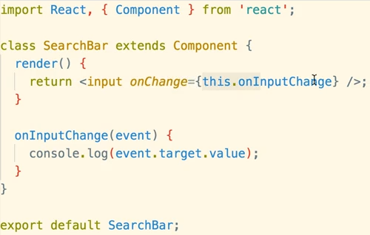
Class component
Class based components are more intelligent that functional compo In terms of dealing with Other components.
Add event handler

Slide 8
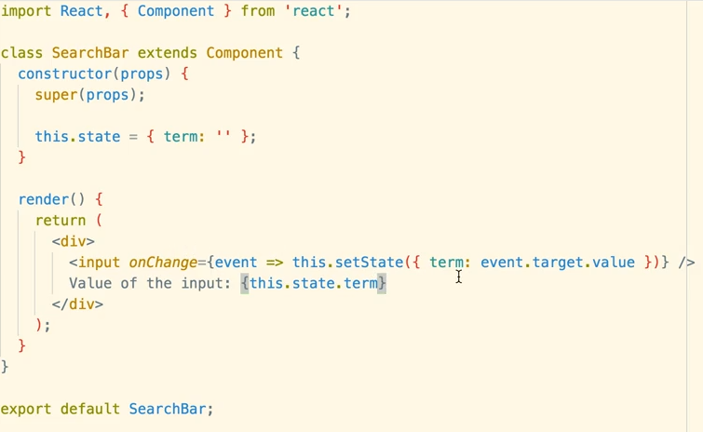
State in React
State is a plain js object that exists on any class based component.

Slide 9
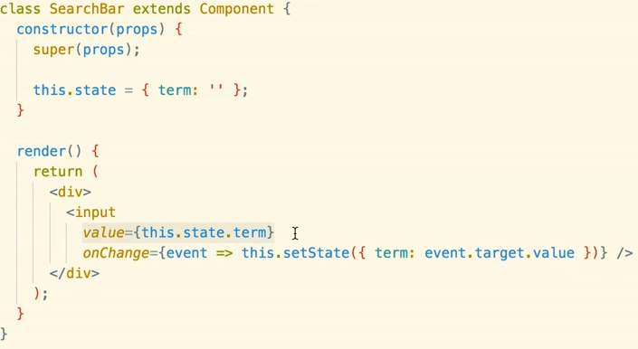
Controlled components
Till now the change in input is changing the state. But here the change in state will change some component.
Now input is a controlled component. The value of input is dependent on the term of the state and not vice versa.
When user updates the input, they call the event, this event changes the state and that changes the value on the input.

Slide 10
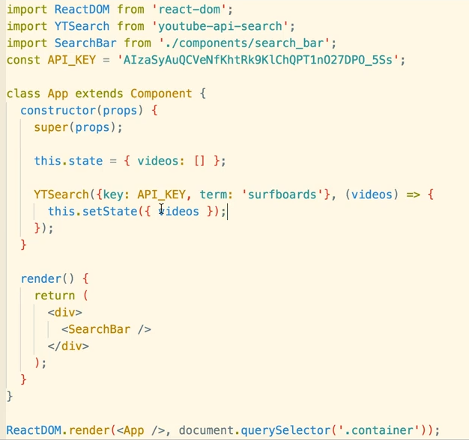
Change index.js to have class components and state

Slide 11
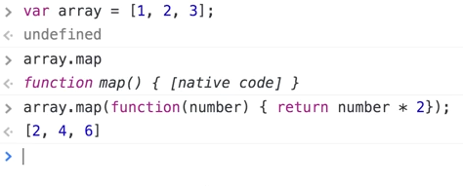
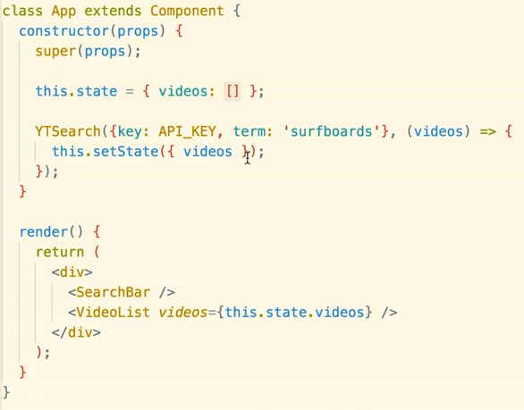
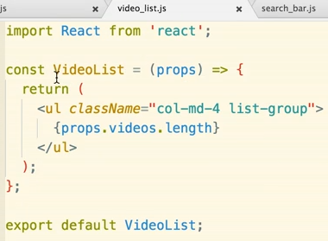
Video_list.js

